Slide 1

Barrantagh Small Cap Canadian Equity Fund
Investment Growth (CDN$) *
Time Period: Jan 1 2008 to March 31, 2026
Barrantagh Investment Management Inc. is a bottom-up, value driven investment manager with over 20 years history of offering investment services to both high net worth and institutional clients. Our investment philosophy is based on three key values. When we look for investment ideas we start with superior businesses with clear competitive advantages and the ability to sustain their profitability throughout the full cycle. Once identified, we look to interview management and ensure they are quality people with goals and targets that align with shareholders. This includes a proven track record of conservative and clear business strategy. The final tenet is our buy and sell discipline around attractive prices, based our independent valuation. We use our own cash flow analysis to establish both buy and sell targets in order to build our high conviction and focused portfolios.
Trailing Returns *
As of March 31, 2026
 | YTD | 1 Yr | 3 Yrs | 5 Yrs
Barrantagh Small Cap Fund | 9.9% | 32.3% | 9.5% | 6.3%
Investment Annual Performance Chart *
Current Portfolio – Equity Sectors
Portfolio Date : March 31, 2026
* Barrantagh Small Cap Canadian Equity Composite performance is used to reflect periods prior to Fund Inception. Investment returns shown are provided for informational purposes only and are calculated net of management fees, trading and operating expenses. Returns are annualized for periods greater than 1 year and calculated on a total return basis which includes changes in net asset value, income and capital gains (losses). Returns do not include the impact of any sales, redemption, optional charges, or any income taxes payable by the unitholder. Past performance is no guarantee of future performance and future performance will fluctuate with future market outcomes.

Slide 2
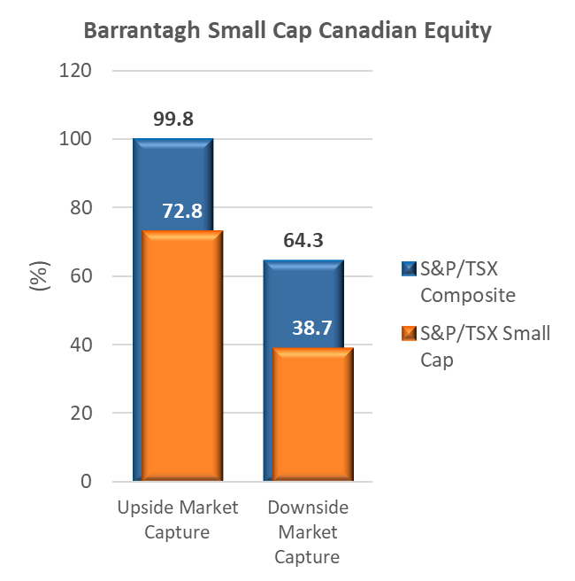
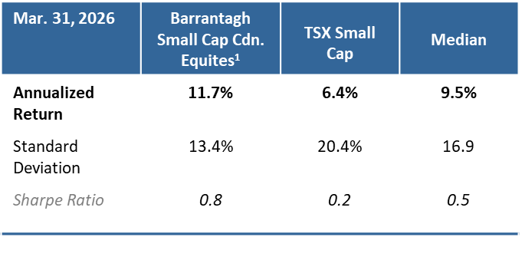
Barrantagh Small Cap Canadian Equity Fund
Top 10 Holdings
As at March 31, 2026 | Portfolio Weighting %
Exchange Income Corp. | 4.9
Kelt Exploration | 4.7
MDA Space | 4.6
Headwater Exploration | 4.5
Calian Group | 4.4
Bird Construction | 4.3
Trican Well Services | 4.2
Chemtrade Logistics | 4.1
Trisura | 4.1
First Capital REIT | 4.0
Q1 2026 Commentary
Positive momentum from 2025 continued into the new year, with a broadening of returns and strength in small caps and value. The tech/AI sell-down or “SaaS-pocalypse” had investment flows shifting from some areas of the market that had seen sustained gains, into other areas of the market that were under appreciated. We had highlighted through the last two years the valuation opportunity in small caps and our enthusiasm for appreciation, this has started playing out over the last six months.
At the same time, the overwhelming driver for relative Canadian small-cap performance continued to be the massive rally in junior mining companies, most materially golds. The materials sector rose 36% in the first two months of the year and grew to ~45% of the benchmark weight. However, with March came open conflict between the U.S. and Iran and markets shifted firmly to risk off. Counterintuitively, gold sold off aggressively sending the junior mining complex sharply lower, showing just how much momentum was in the trade and how overbought the sector was (conflict risk normally good for gold). The unwinding of a crowded trade is very positive for the small cap portfolio as we manage a diversified basket of quality-value companies versus chasing any one hot sector. Further, our oil-weighted energy holdings (Headwater Exploration, new addition Spartan Delta) provided positive benefit from the disruption in energy markets and conflict in the Middle East.
During the period, the industrials sector was the greatest area of absolute and relative returns. Portfolio holdings in construction (Aecon Group, Bird Construction), aerospace and defence (Calian Group, Exchange Income, MDA Space) and critical infrastructure (Westshore Terminals) all delivered strong performance with underlying earnings acceleration. Health care was another large positive where senior-housing exposed holding Extendicare continued to deliver accretive growth and garner more appreciation in the market for its positive transformation. This was offset with detractions in materials (underweight mining), energy (underweight uranium), and financials (negative security selection).
Entering the second quarter volatility remains high. Markets sit in “limbo” mode with underlying positive economic momentum to start the year, competing against the uncertainty of increased global conflict and the impact to energy prices, inflation, interest rates and risk appetite. As markets gyrate daily around every Trump tweet and Middle East headline, we believe the Portfolio is well positioned to weather the noise and take advantage of the larger trend – broadening of market returns and more recognition of the unique and attractive value proposition that Canadian small caps provide.

