Slide 1
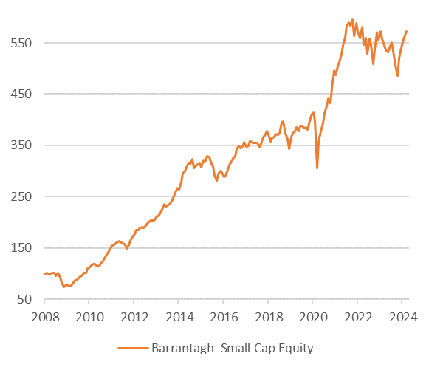
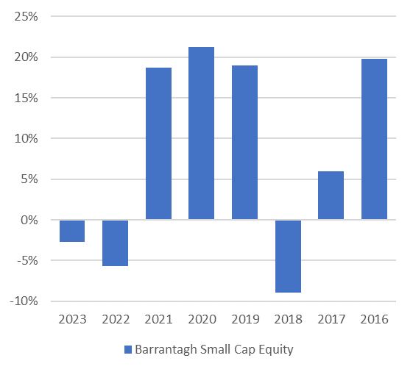
Barrantagh Small Cap Equity Portfolio
EQUITY MANAGEMENT
Value bias
Quality focus (strong Balance Sheet / through cycle profitability)
Disciplined bottom-up research process
Management interviews
Low turnover
High conviction portfolios
Small Cap Canadian Equities
20 - 40 small cap Canadian stocks
<$2bn market cap, >1% dividend yield at time of
purchase
Investment Growth (CDN$) *
Time Period: Jan 1, 2008 to Mar 31, 2024
Asset Allocation – Barrantagh Small Cap Equity
Portfolio Date: March 31, 2024
Current Portfolio – Equity Sectors
Portfolio Date: March 31, 2024
Investment Performance Chart *
Top 5 Holdings
Portfolio Date: March 31, 2024
* Investment returns shown are provided for informational purposes only and are calculated before management fees (gross of fees). Returns are annualized for periods greater than 1 year and calculated on a total return basis which includes income and capital gains (losses). Investment performance is calculated from a composite of identical client accounts. Past performance is no guarantee of future performance and future performance will fluctuate with future market outcomes.

