Slide 1

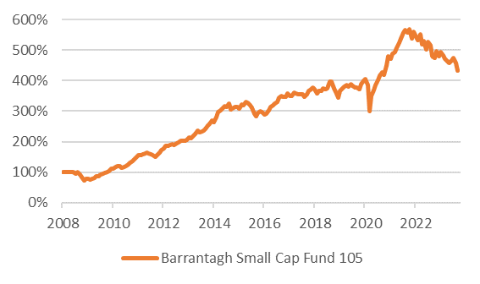
Barrantagh Small Cap Canadian Equity Fund
Investment Growth (CDN$) *
Time Period: Jan 1 2008 to Sept 30, 2023
Barrantagh Investment Management Inc. is a bottom-up, value driven investment manager with over 20 years history of offering investment services to both high net worth and institutional clients. Our investment philosophy is based on three key values. When we look for investment ideas we start with superior businesses with clear competitive advantages and the ability to sustain their profitability throughout the full cycle. Once identified, we look to interview management and ensure they are quality people with goals and targets that align with shareholders. This includes a proven track record of conservative and clear business strategy. The final tenet is our buy and sell discipline around attractive prices, based our independent valuation. We use our own cash flow analysis to establish both buy and sell targets in order to build our high conviction and focused portfolios.
Investment Annual Performance Chart *
Current Portfolio – Equity Sectors
Portfolio Date : Sept 30, 2023
* Barrantagh Small Cap Canadian Equity Composite performance is used to reflect periods prior to Fund Inception. Investment returns shown are provided for informational purposes only and are calculated net of management fees, trading and operating expenses. Returns are annualized for periods greater than 1 year and calculated on a total return basis which includes changes in net asset value, income and capital gains (losses). Returns do not include the impact of any sales, redemption, optional charges, or any income taxes payable by the unitholder. Past performance is no guarantee of future performance and future performance will fluctuate with future market outcomes.

Slide 2
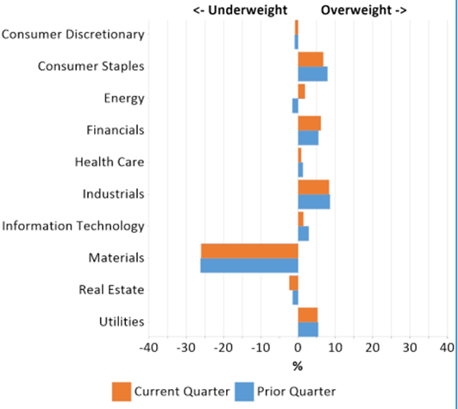
Barrantagh Small Cap Canadian Equity Fund
Industry Distribution vs. Benchmark (Sept 30, 2023)
Third Quarter Commentary
Canadian equity markets turned red during the third quarter, with negative momentum accelerating in September. Overall performance was buoyed by the energy sector (supported by rising oil prices), while under the surface pain was inflicted on areas with rate-sensitivity (defensives, utilities, real estate, etc.), as the “higher-for-longer” market narrative solidified.
Much has been written this year about the poor breadth this market “rally” has entailed. In the U.S. context, the bellwether cap-weighted S&P 500 is up ~13% year-to-date while the equal-weight equivalent is up just ~1%, as a small number of large-cap stocks have driven performance. This poor breadth has also been a factor for Canadian small caps. Excluding the top 10 stocks (~3% of the index), the aggregate return for the benchmark is -5% in 2023. Expanding this to the top 10% of stocks, the remaining 90% are -8% on the year, while excluding the top quartile shows -11% for the remaining three quarters of the index. If you have been under-indexed to pockets in energy, resources, and cyclicals, 2023 has been a challenging period.
It has been a challenging year so far for Canadian small cap investors with trading activity increasingly volatile on company updates. The market has taken a “shoot first, ask questions later” mentality on negative revisions (however short term they may be) or perceived macro headwinds. For example, for a representative basket of stocks in the portfolio that underperformed during the quarter, consensus earnings expectations actually increased ~1% over the three months. However, the negative moves in the stocks were driven by sentiment, with multiples compressing ~14% during the same period. Market emotion has swung much more towards the immediate-term environment versus the future earnings power of the business. For this same basket of stocks, the market currently ascribes trading multiples ~33% below their individual five-year averages. We acknowledge the higher rate environment today and the real impact on valuations, but also highlight the drastic undershoot that can occur on high quality names currently out of favour – and the large latent valuation upside potential in the portfolio.

