Slide 1
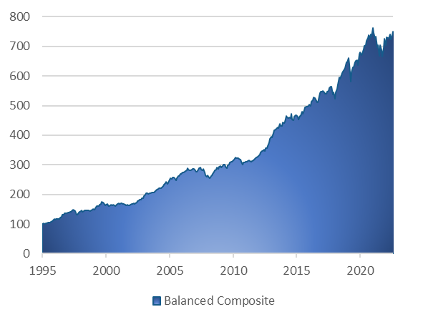
Barrantagh Global Balanced Portfolio
MANAGEMENT STYLE
Value bias
Quality focus (strong Balance Sheet / full cycle profitability)
Disciplined bottom-up research process
Management interviews
Low turnover
High conviction portfolios
Minimum 7 industry sectors
Global Balanced
Capital preservation & growth
Active asset allocation
20 - 40 bonds: core duration strategy & active sector allocation
20 - 40 Canadian stocks (all cap)
20 - 40 Global stocks (U.S. and International ADR’s)
Investment Growth (CDN $)*
Time Period: January 1, 1996 to Sept 30, 2023
Asset Allocation – Barrantagh Balanced Portfolio
Portfolio Date: Sept 30, 2023
Trailing Returns *
As of Sept 30, 2023
Current Portfolio – Equity Sectors
Portfolio Date : Sept 30, 2023
Investment Performance *
Top 5 Equity Holdings
Portfolio Date : Sept 30, 2023
* Investment returns shown are provided for informational purposes only and are calculated before management fees (gross of fees). Returns are annualized for periods greater than 1 year and calculated on a total return basis which includes income and capital gains (losses). Investment performance is calculated from a composite of identical client accounts. Past performance is no guarantee of future performance and future performance will fluctuate with future market outcomes.

